Slide 1
Custom Resource Definition
Draft 2.0

Slide 2
What are CRD’s ?
A custom resource is an object that extends the Kubernetes API or allows you to introduce your own API into a project or a cluster.
A custom resource definition (CRD) file defines your own object kinds and lets the API Server handle the entire lifecycle.

Slide 3
Why CRD’s in CIS ?
The native kubernetes resources like ingress or routes cannot be modified to support certain BIG-IP features which can be extended, or CIS can better serve the customer requirements or use-cases with CRD.
Examples: profiles, ciphers, WAF, Whitelisting and many.

Slide 4
Thumb Rules for CRD’s Implementation for CIS
Rule 1:
Host and BIG-IP Virtual Server are 1:1 mapped.
Rule 2:
Group of homogenous services can be defined in one CR.
Rule 3:
Group of CRs of same Host to form one Virtual Server in BIG-IP.

Slide 5
Thumb Rules for CRD’s Implementation for CIS
CR-1
CR-2
In the above picture, svc-1 and svc-2 are two similar services which use edge termination and have all similar properties so they can be defined in a single CR(CR-1), unlike svc-3 which use Re-encrypt termination and should be used in a different Custom Resource(CR-2).
All these these three services are created as pools in BIG-IP for
one Virtual Server (F5_CIS_ecommerce).
BIG-IP
EDGE TERMINATION
LOGIN (svc-1)
Virtual Server
ecommerce.com
LOGOUT (svc-2)
Pool-1
Pool-2
Pool-3
RE-ENCRYPT TERMINATION
TRANSACTION (svc-3)

Slide 6
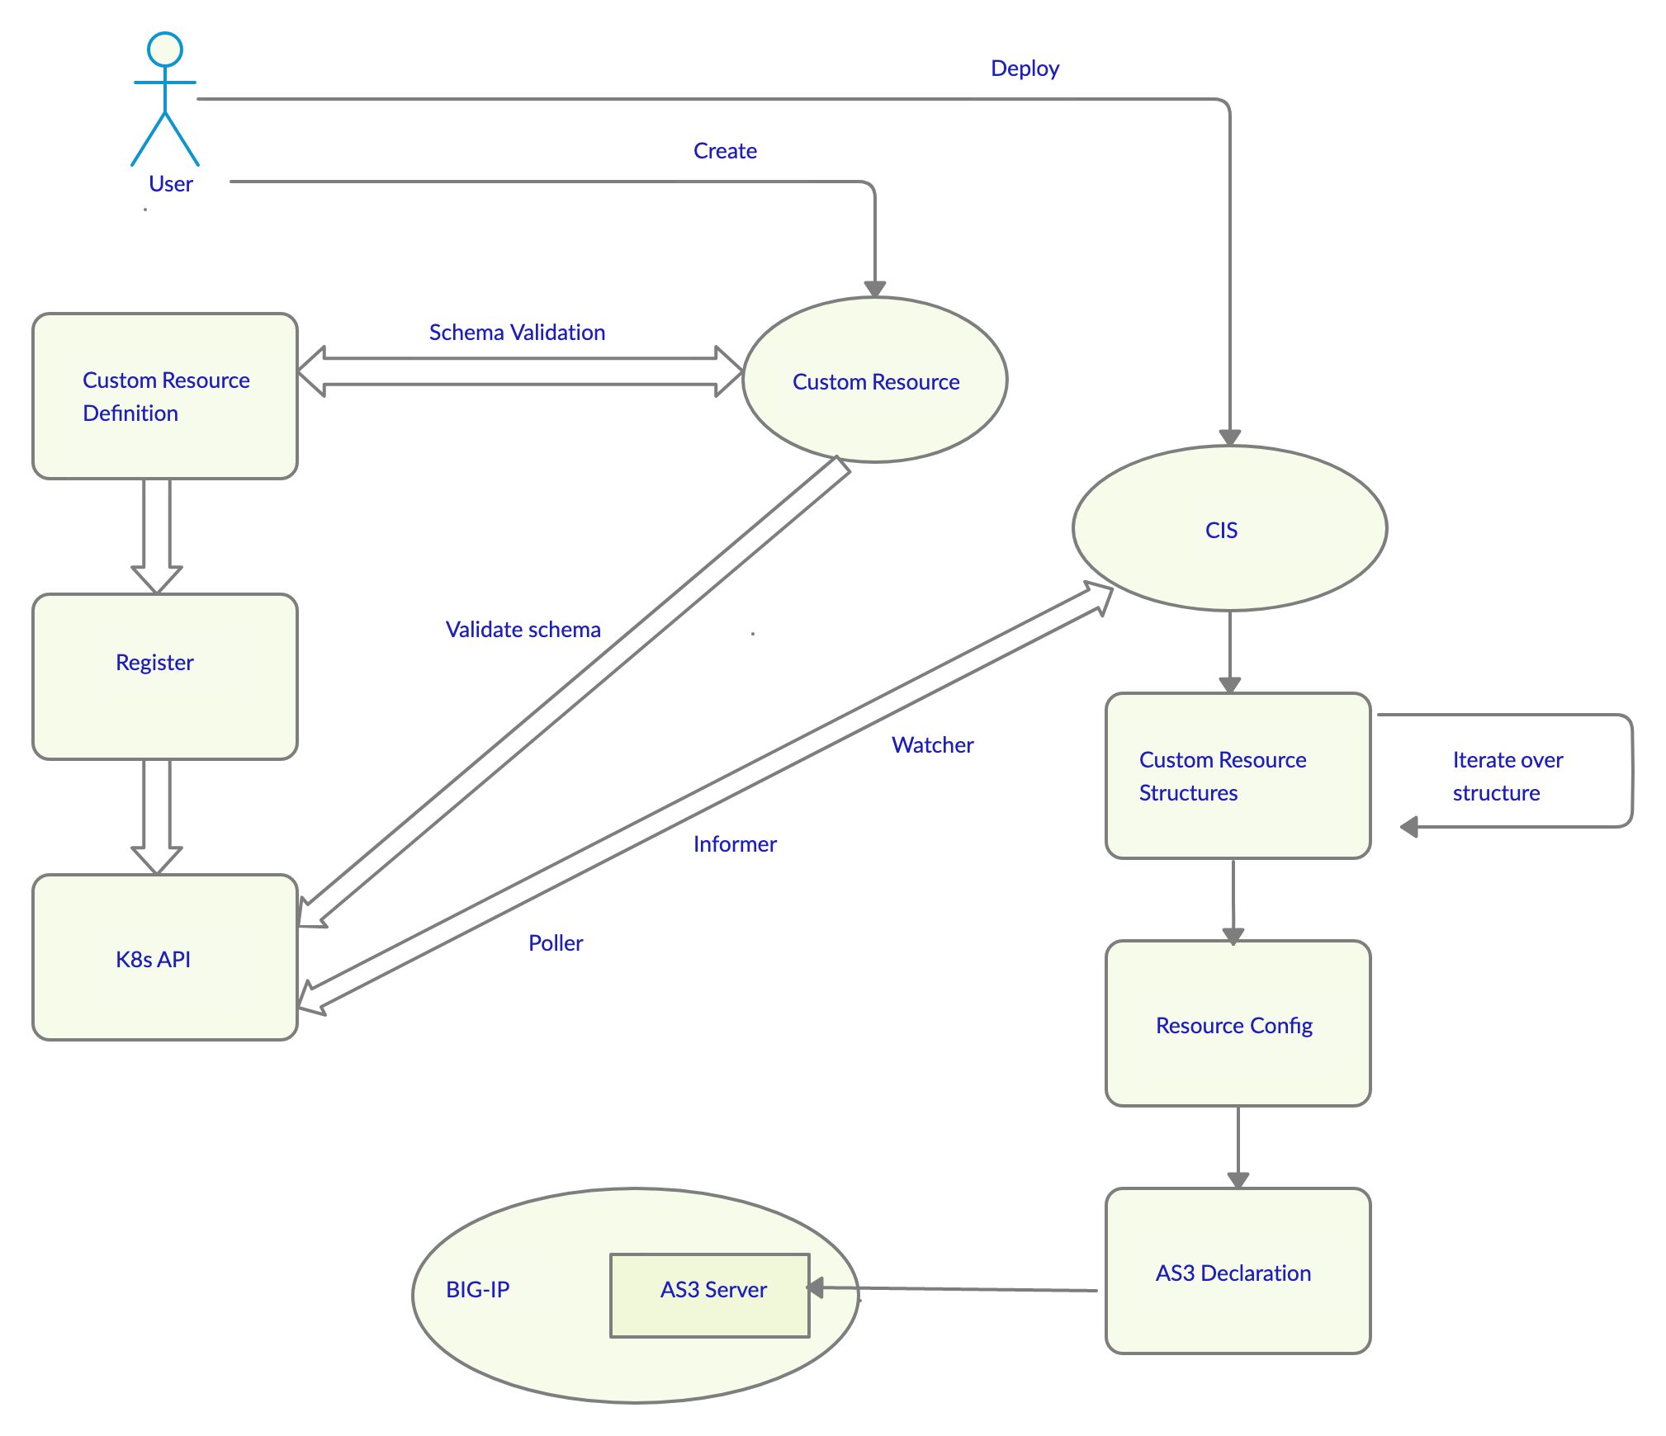
High level flow of CRD

Slide 7
Types of CRD
Virtual Server
Profiles
Team to think of any other (Exploring the requirements)
IRULE?
Pool Properties?

Slide 8
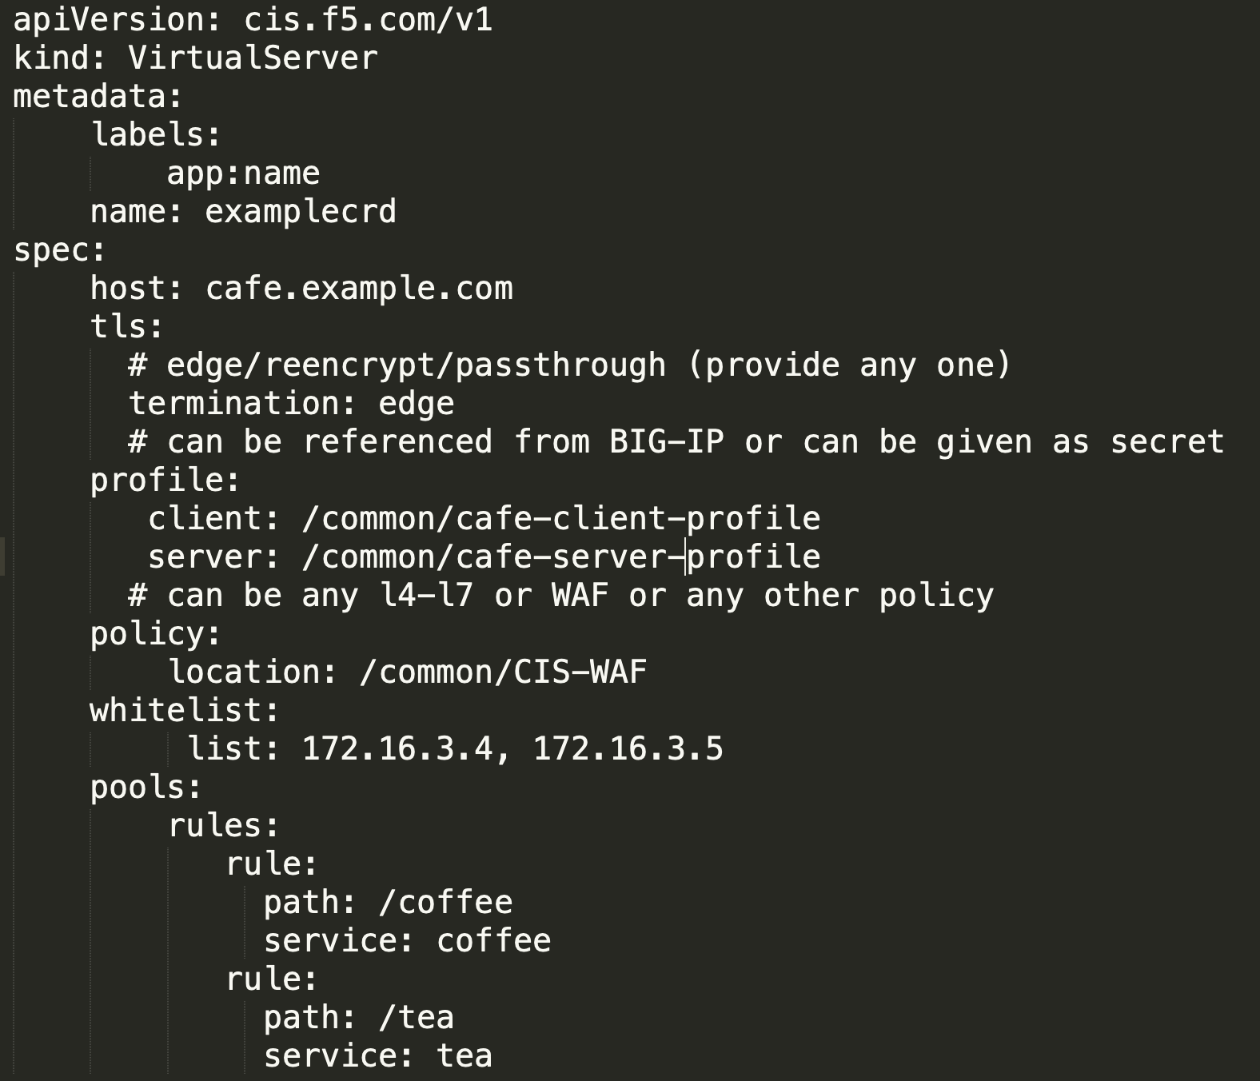
Virtual Server Custom Resource

Slide 9
Profile Custom Resource
BIG-IP supports a huge variety of options to configure ciphers, cipher groups, list options, certs.
CIS wants to make a complete use of these features and build a CRD for profiles.
This will be strong selling point for CIS over other controllers in the market.
Design for the profile CRD is still in-progress.
We are planning to implement profile CRD once we are successful in implementing the Virtual Server CRD.

Slide 10
CRD ALPHA Release
Create a simple custom resource as shown in slide no.8
Deploy the custom resource, create a schema and validate it against the schema.
Create informers for Virtual Server Custom Resource.
Deploy CIS.
CIS should process the Custom Resource and create the Internal Data Structure.
Using agent AS3, CIS will push the configuration to BIG-IP
Verify the end-to-end traffic.

Slide 11
Thank you
- Team CIS

